Slide 1
Applied Personnel Issues
Motivation and Teams

Slide 2
Topics
Motivation
Team Guidelines
Notes:
From text, chapters 11, 12
chapter 13 to be added later

Slide 3
Motivation
Given a case study describing a project, the learner will
  analyze the project for motivation factors
  according to the list of factors in the text
Notes:
Recall of people, process, product and technology, the most important is people.
Motivation is the single greatest influence on how well people perform.

Slide 4
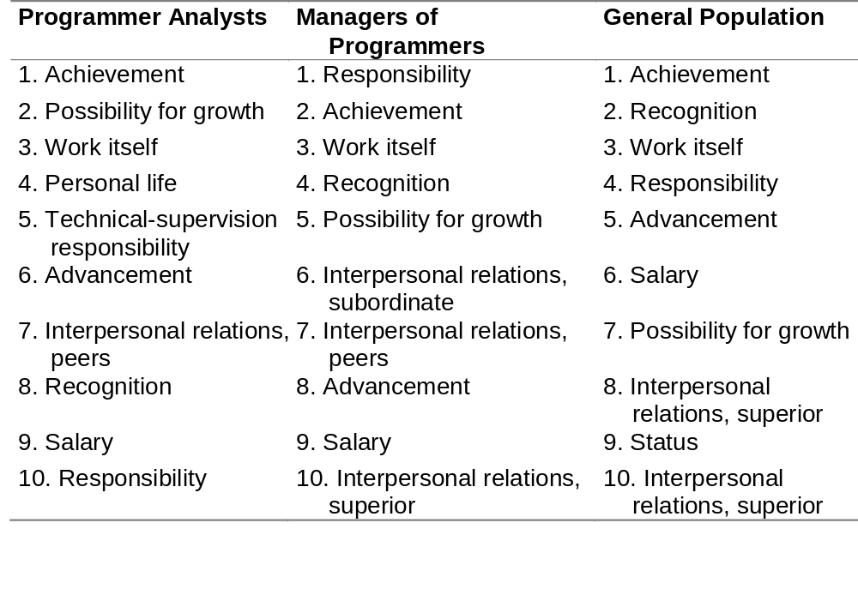
Motivation Factors
Notes:
For managers, personal life is 15th, technical-supervision opportunity 13th.
For programmer analysts, interpersonal relations with superiors is 11th, with subordinates is 13th
If managers try to motivate developers the way they like to be motivated, its likely to fail.
Note managers have all three interpersonal relations in the top 10.
Discuss patterns - class find them.
Text suggests “impossible goals may be inspiring to Fs but T’s reject them for being illogical” (80% of SW people T) - discuss

Slide 5
Top Five Factors - Achievement
Developers like to work and achieve
Ownership
  let developers create own schedules
Goal setting
  explicitly set development-speed objective
  explicitly set other important goals
  keep goals from changing
  ensure set of goals is collectively achievable

Slide 6
Top Five Factors:
Possibility for Growth
Developers have chosen to be in a field that is constantly changing
Align growth goals of organization with growth goals of individual
Things to try:
  provide tuition reimbursement for classes
  give time off to attend class or study
  reimbursement for professional books
  projects that will expand skill sets
Notes:
Other things to try?
Companies in top 10% of their industries in quality and productivity typically provide 2 weeks of training per year for software developers and 3 weeks per year for managers (Jones - “Assessment and Control of Software Risks”, 1994).

Slide 7
Top Five Factors:
Work Itself
Five dimensions of work that contributes to motivation:
  exercises a variety of skills
  completes a whole, identifiable piece of work
  affects other people and has value
  worker has control over means and methods used
  provides feedback about how effective you are
Quality usually more motivating than schedule
Allow focus on work itself
Notes:
Focus on work - reduce admin. tasks to minimum necessary, or show how it contributes to getting the work done.

Slide 8
Top Five Factors:
Personal Life
Fourth for developers, fifteenth for managers
Make sure developers have time for personal lives
  respect holidays
  schedule for vacations
  be sensitive to occasional requests for time off during work day

Slide 9
Top Five Factors:
Technical-Supervision Opportunity
Represents an achievement (connects with first motivator)
Assign each person to be technical lead for a particular product area
  user interface, database, networking, etc.
Assign each person to be technical lead for process area
  reviews, reuse, integration, tools, testing, etc.
Assign nonjunior people to be mentors

Slide 10
Rewards and Incentives
Sincere praise for a specific achievement
Team T-shirts, mugs, posters, ...
Humourous or serious awards
Special events for significant accomplishment
Exceptions to company policies (casual day)
Sponsorship to conferences
Promotions
Bonuses
Notes:
Be sure the rewards say “appreciation” and not “incentive” or “manipulation”

Slide 11
Other Motivators
Pilot projects
  Hawthorne effect - conducting the experiment increases productivity
  run projects as pilots, trying something new
  gather data on the effect of the change
Performance reviews
  major impact on motivation, positively or negatively
  be sure effect is positive

Slide 12
Morale Killers
Hygiene factors
Management manipulation
Excessive schedule pressure
Lack of appreciation for developer efforts
Inappropriate involvement of technically inept management
Not involving developers in decisions that affect them
Productivity barriers
Low quality
Heavy-handed motivation campaigns
Notes:
Hygiene factors: absence demotivates, presence does not improve motivation beyond a certain point - see next slide
Examples of decisions that affect developers on following slide

Slide 13
Sample Hygiene Factors
Appropriate lighting, heating, air-conditioning
Adequate desk and shelf space
Enough quiet for concentration
Enough privacy to prevent unwanted interruptions
Up-to-date computer equipment, software
Applicable software tools
Applicable reference manuals and trade publications
At least minimal training in software, tools, methods
Freedom to set work hours

Slide 14
Sample Decisions
Affecting Developers
Committing to new schedules
Committing to new features or feature mods
Hiring new team members
Volunteering developers for assignments outside the project
Designing the product
Making technical tradeoffs
Changing office space
Changing computer hardware or software tools

Slide 15
Teamwork:
High-Performance Team
Shared, elevating vision or goal
Sense of team identity
Results-driven structure
Competent team members
Commitment to the team
Mutual trust
Interdependence among team members
Effective communication
Sense of autonomy
Sense of empowerment
Small team size
High level of enjoyment
Notes:
Chapter 12
Vision is arbitrary as long as team shares it
why teams fail is opposite of these, plus morale-killers.

Slide 16
Results-Driven Structure
Clear roles and accountability
Effective communications
Way of monitoring individual performance
Decisions based on facts rather than subjective opinions

Slide 17
Long-Term Teambuilding
Some reasons to keep teams together from project to project
  higher productivity
  lower startup costs
  lower risk of personnel problems
  less turnover
Trade off costs of idle time with costs of rebuilding
  top team is worth preserving
Notes:
worth 1/3 to 1/2 of yearly salary to keep top team versus an average team
What could you do with them between paying projects? - discuss

